Slide 1

CMSC 137
Data Communications and Networking
Lecture Module
10 – Transmission Media

Slide 2
Module 10: Transmission Media
Rozano S. Maniaol
Lecturer

Slide 3
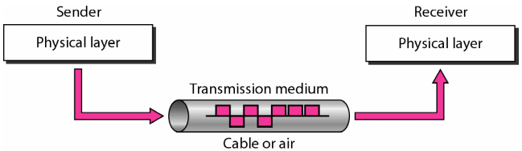
Introduction
Layer 0
Anything that can carry information from a source to destination
Electromagnetic energy – a combination of electric and magnetic fields vibrating in relation to each other: power, radio waves, infrared light, etc.
Portions of electromagnetic spectrum

Slide 4
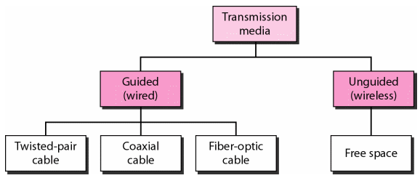
Classification of Transmission Media

Slide 5
Wired Media

Slide 6
Twisted Pair Cable

Slide 7
Twisted Pair Cable
Consists of 2 conductors, each with its own plastic insulation twisted together
One wire is used to carry signals to the receiver, another is for ground reference
If the two wires are parallel, effect of unwanted signals is not the same since they are located at different distance relative to the noise
Applications: telephone lines, DSL, LANs

Slide 8
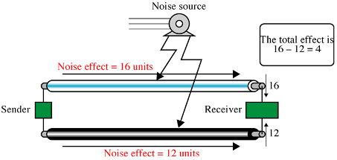
Effect of Noise on Parallel Lines

Slide 9
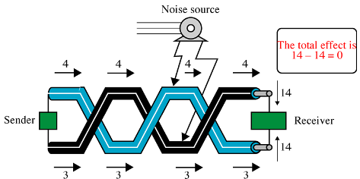
Effect of Noise on Twisted Pairs

Slide 10
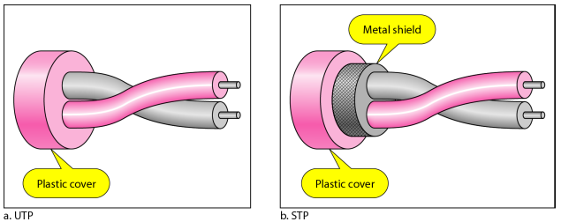
Shielded vs Unshielded Twisted Pair
Unshielded Twisted-Pair (UTP) - most common twisted-pair cable used
Shielded Twisted-Pair (STP) – produced by IBM; has metal foil or braided-mesh covering

Slide 11
Categories of Copper Cables
Category | Data Rate | Max Length | Application
CAT 1 | Up to 1 Mbps | - | Old telephone cables
CAT 2 | Up to 4 Mbps | - | Token Ring networks
CAT 3 | Up to 10 Mbps | 100m | Token Ring & 10BASE-T Ethernet
CAT 4 | Up to 16 Mbps | 100m | Token Ring networks
CAT 5 | Up to 100 Mbps | 100m | Ethernet, Fast Ethernet, Token Ring
CAT 5e | Up to 1 Gbps | 100m | Ethernet, Fast Ethernet, Gigabit Ethernet
CAT 6 | Up to 10 Gbps | 100m | Gigabit Ethernet, 10G Ethernet (55m)
CAT 6a | Up to 10 Gbps | 100m | Gigabit Ethernet, 10G Ethernet (55m)
CAT 7 | Up to 10 Gbps | 100m | Gigabit Ethernet, 10G Ethernet (100m)

Slide 12
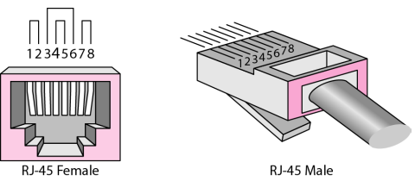
UTP Connector
Legend:
RJ - Registered Jack

Slide 13
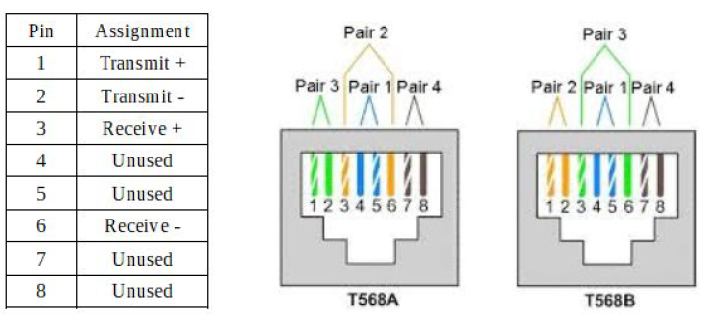
UTP Color Coding Standard

Slide 14
Coaxial Cables

Slide 15
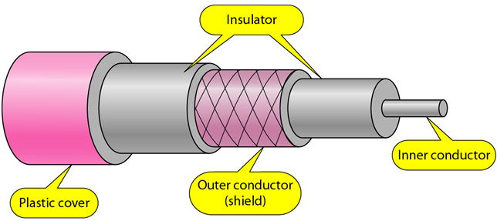
Coaxial Cables
Has a central core conductor of solid or stranded wire enclosed in an insulating sheath, which is in turn, encased in an outer conductor of metal foil, braid or combination of the two
Can carry signals of higher frequencies than twisted pair
Applications: telephone lines, cable, LANs

Slide 16
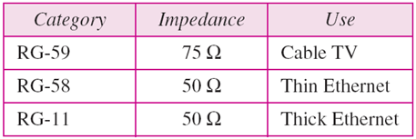
Categories
Thicknet (10BASE-5) – uses RG-11 to transmit 10 Mbps with a range of 5000m
Thinnet (10BASE-2) – uses RG-58 with BNC connectors to transmit data at 10 Mbps with a range of 185m
Legend:
RG – Radio Government

Slide 17
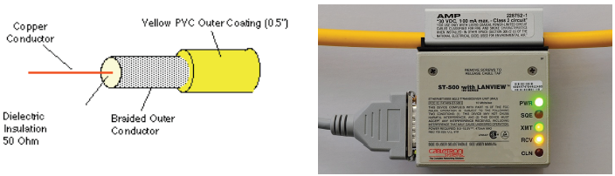
RG-11

Slide 18
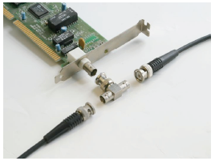
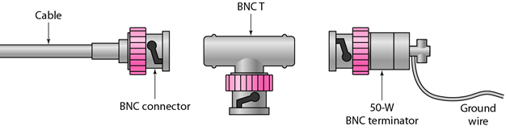
RG-58
Bayonet-Neill-Concelman (BNC)
Source: nsrc.org

Slide 19
Fiber Optic Cables

Slide 20
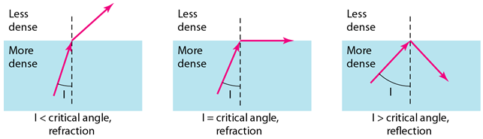
Fiber Optic Cable
Made of glass or plastic, transmit signals in the form of light
Nature of light
  Light travels in a straight line as long as it is moving through a single uniform substance
  If a ray of light traveling through one substance suddenly enters another substance (of a different density), the ray changes its direction

Slide 21
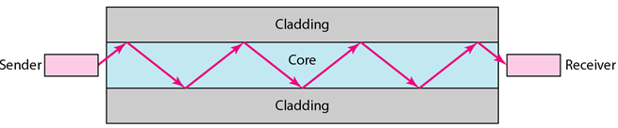
Fiber Optic Cable
Uses reflection to transmit
Glass or plastic core is surrounded by a cladding made of less dense glass or plastic

Slide 22
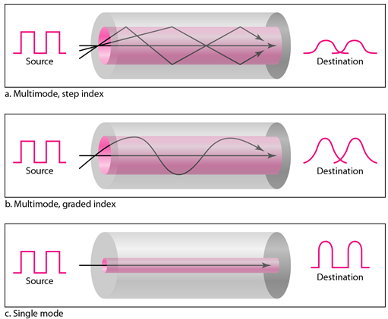
Propagation Modes

Slide 23
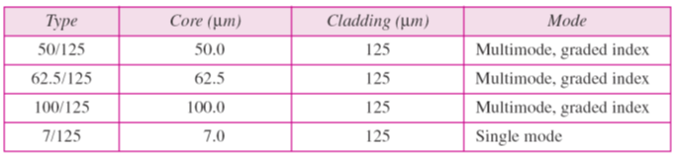
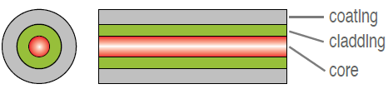
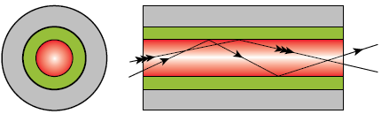
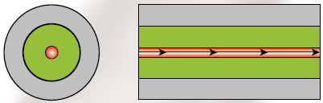
Fiber Types
Multimode
Single mode

Slide 24
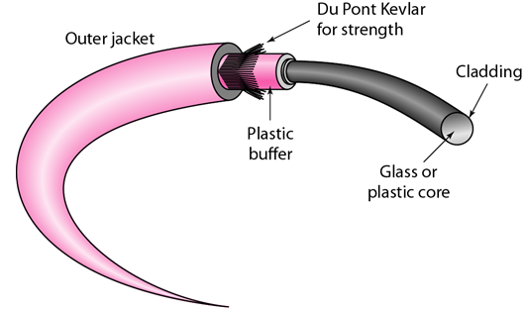
Fiber Construction

Slide 25
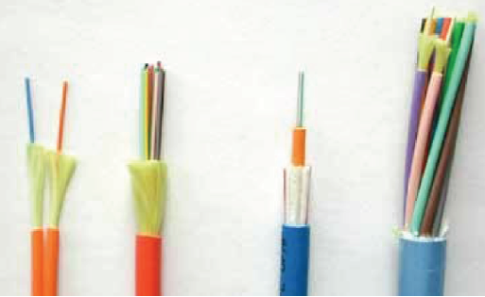
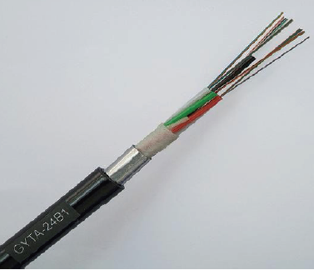
Fiber Packages
Indoor Fiber Packages
Outdoor Fiber Packages

Slide 26
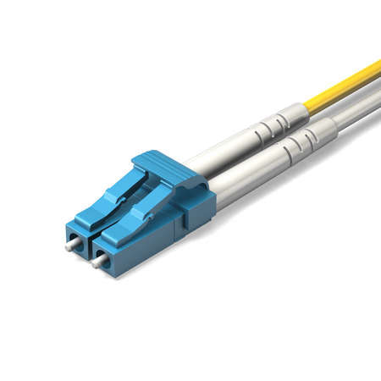
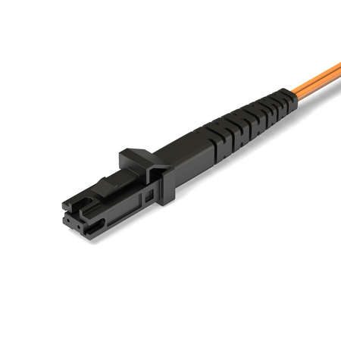
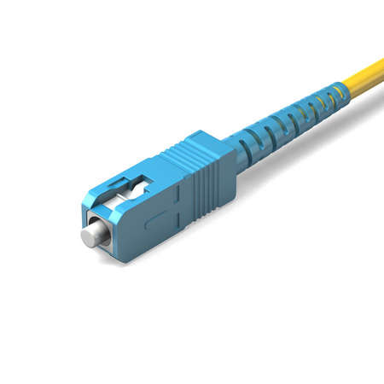
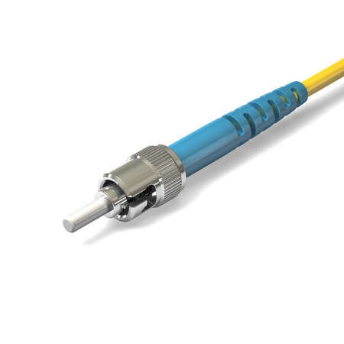
Fiber Optic Connectors samples
LC connector
MTRJ connector
SC connector
ST connector
https://www.cablestogo.com/learning/connector-guides/fiber-networking
Legend:
LC – Lucent Connector
MTRJ – mechanical transfer registered jack
SC – subscriber channel
ST – straight tip

Slide 27
Fiber Optic Cables
Advantages
  Higher bandwidth
  Less signal attenuation
  Immunity to electromagnetic interference
  Resistance to corrosive materials
  Lightweight
  Greater immunity to tapping
Disadvantages
  Installation and maintenance
  Unidirectional light propagation
  Cost

Slide 28
Wireless Media

Slide 29
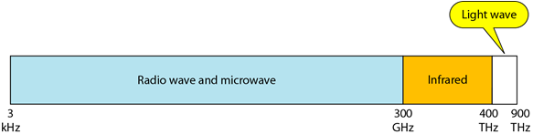
Unguided Media
Transmit without a physical conductor
Aka wireless communication
Signals broadcasted through free space and available to anyone with a receiver
Electromagnetic spectrum for wireless communication

Slide 30
Propagation Mode
Ground Propagation
  Radio waves travel through the lowest portion of the atmosphere, hugging the earth
  The low frequency signal follow the curvature of the planet
  Distance depends on the amount of the power
Sky Propagation
  Higher frequency radio radiate upward into the ionosphere where they are reflected back to the earth
  Sky propagation allow for greater distance with lower power output
Line of Sight Propagation
  Very high frequency signals are transmitted in straight lines directly from antenna to antenna

Slide 31
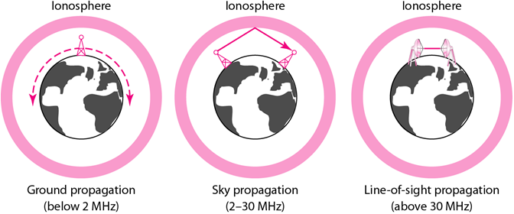
Propagation Mode

Slide 32
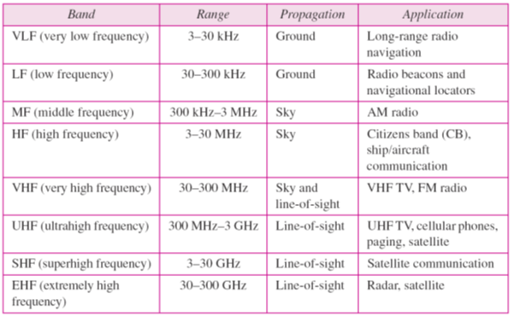
Bands

Slide 33
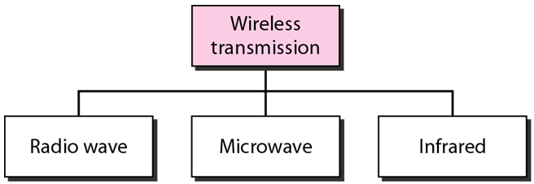
Wireless Transmission Group

Slide 34
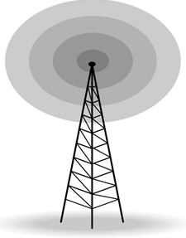
Radio Waves
Frequency range of 3 kHz to 1 GHz
Omnidirectional – signals propagate in all directions
Signals can penetrate walls
Susceptible to interference by another antenna that sends signals using the same frequency or band
Applications: multicasting

Slide 35
Microwave
Frequency range from 1 to 300 GHz
Unidirectional – sending and receiving needs to be aligned
Line-of-sight propagation
Signals cannot penetrate walls
Wider sub bands and higher data rate
Applications: unicast, cellular networks, satellite networks, wireless LANs

Slide 36
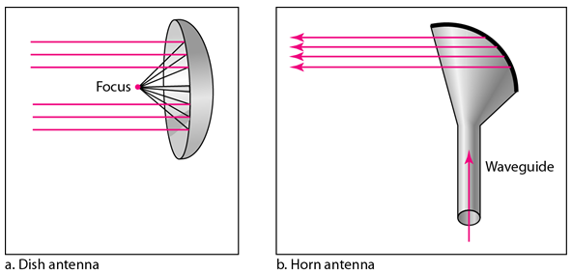
Unidirectional Antenna

Slide 37
Infrared
Frequency range from 300 GHz to 400 THz
Short range communication
Signals cannot penetrate walls
Applications: IrDA (Infrared Data Association) port, communication between devices
Line-of-sight propagation

Slide 38
References
Forouzan, B.A. 2013. Data Communications and Networking, 5th Ed. McGraw-Hill, New York.

